Slide 1
N25 Glenmore to Luffany Speed Limit Review
Seamus Kavanagh,
Senior Engineer
21st July 2025

Slide 2


N25 Speed Limit Proposal
Proposed speed limit change on the N25
100km/h reduced to 80km/h
From Luffany Roundabout to 500m north of Ballinclare Junction (L7522)
2

Slide 3
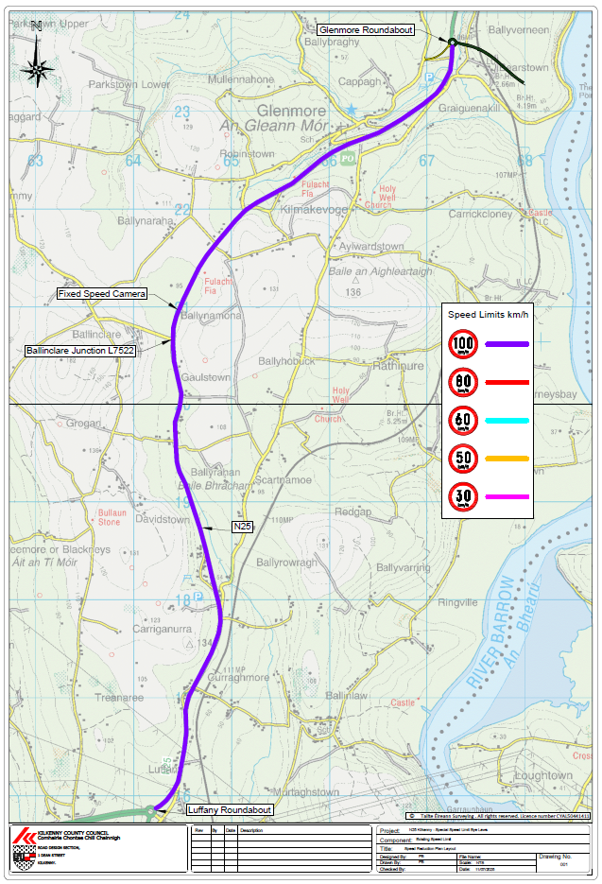
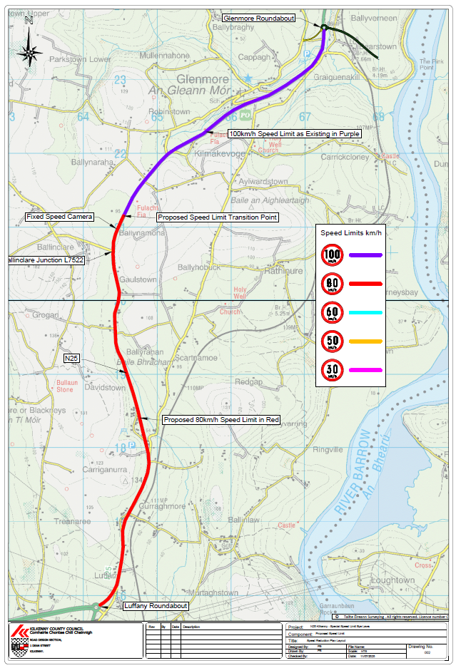
N25 Existing Speed Limit
N25 Proposed Speed Limit
3

Slide 4
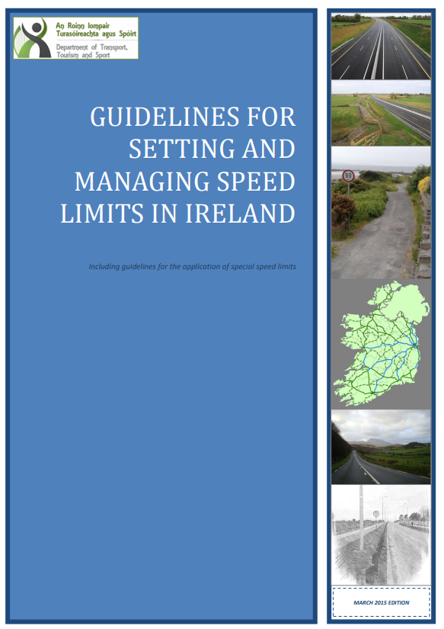
N25 Speed Limit Proposal
N25 assessed using Guidelines for Setting and Managing Speed Limits in Ireland
Proposed 80km/h extents based on technical guidelines
Independent report produced
4

Slide 5
N25 Speed Limit Proposal – Independent Report
ADT of 14,260 with 8.5% HGV - 80km/h would reduce speed disparity between cars and HGVs and reduce overtaking
Proposed 80km/h section has collision rates up to twice national average. Reduced speeds reduce collision impact severity
High number of residential and agricultural accesses on proposed 80km/h section – 80km/h would favour these accesses
Reducing speed limit on climbing lanes unreasonable due to road safety and operational performance. In addition, climbing lane section has twice below average collision rates
5

Slide 6
N25 Speed Limit - What's Next?
N25 speed limit reduction managed through an amendment to the 2023 Special Speed Limit Bye-Laws
Pre-Draft Consultation Phase closed on the 08th July 2025
Amended Bye-Laws Public Consultation will open on 23rd July 2025 until 16:00 on the 04th September 2025
Proposals to be sent to the Garda Commissioner
Consent for approval to be sent to Transport Infrastructure Ireland. Required prior to bringing Bye-Laws for adoption
6
Notes:
Updates to the Guidelines were provided in May 2024

Slide 7
THANK YOU

