Slide 1
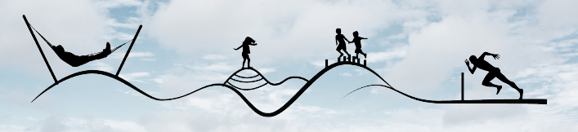
Projects Office – Recreational Infrastructure Update
Council Meeting - January 2022

Slide 2
Outdoor Recreational Instructure Scheme 2018- 2021
ORIS MEASURE 1
Freshford Loop Walk Upgrade 2020/2021
Cois Bearbha Riverside Looped Walk – Enhancement Scheme 2020/2021
Brandon Hill Summit Walk - 2020/2021
Nore Valley Walk – 2020/2021
Woodstock Estate - Promotion & Marketing 2020-2021
Freshford Loop Walk - Surface upgrade 2019/2020
Lingaun valley Trail - Website design & development of advertising material 2019/2020
Kilkenny Outdoor Activity Trail -- Marketing of amenities 2019/2020
Tory Hill - Improvement works to existing walking trail 2019/2020
Woodstock Estate - Promotion & Marketing – 2019/2020
South Leinister Way – Rehabilitation
Trail Kilkenny Directory
Freshford Loop Walk 2018
Castlecomer Discovery Park 2018
Kilkenny City River Walks 2018

Slide 3
Outdoor Recreational Instructure Scheme 2018- 2021
ORIS MEASURE 2
Woodstock Estate Trail Enhancement Scheme -2020/2021
Westcourt (Moat Field Phase 2) Callan Trail Construction Scheme -2020/2021
Abbey Meadows – Callan Walking trail enhancement works, refurbishment of pedestrian bridge over Kings River and upgrading of signage and furniture along trail -2018/2019
Silaire Wood Boardwalk and Trail Rehabilitation Scheme 2019/2020
Poulanassy Waterfall, provision of visitor car park and walking trail development 2019/2020
Outdoor Activity Hub - Construction of new roadside boundary to Brandondale House – 2018/2019
Nore Valley Walk – Environmental Rehabilitation Project 2018
King River Walking Trail 2018
ORIS MEASURE 3
Woodstock Estate - Restoration of Ladies Loop and Woodstock Loop walking trails. – 2018/2019
Total Allocation: c.€1.9m (Incl. Match Funding)

Slide 4
Outdoor Recreational Instructure Scheme 2021 / 2022
ORIS MEASURE 1
Kells – King’s River Walk Enhancement Scheme
Community Loop Walk Network
Woodstock Estate - Promotion & Marketing
Outdoor Kilkenny - Promotion & Marketing
Silaire Wood – Walking Trail Extension
Tory Hill Looped Walk Enhancement Works
The Bishops Meadows – River Nore Swimming Area
PROJECT DEVELOPMENT
Castlecomer Discovery Park - Development of Masterplan

Slide 5
Outdoor Recreational Instructure Scheme 2022
ORIS MEASURE 2
Castlecomer Discovery Park
Woodstock Estate - Accessible Trails , Age Friendly and Disabled Parking and Wheelchair Swing
Disability Participation and Awareness Fund 2021 (Mobility Buggy and Accessible Play Equipment (€56k)
ORIS MEASURE 3
Kilkenny Countryside Park
Total value of works 2021/2022: c.€1.18m (incl. match funding)
Total value of ORIS funding: c.€3.08m (incl. match funding (20% or 10%)

Slide 6
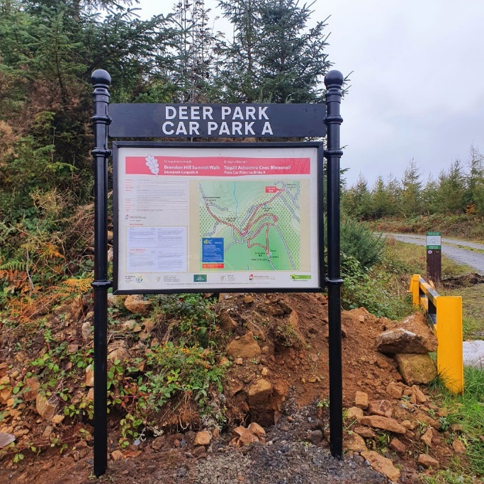
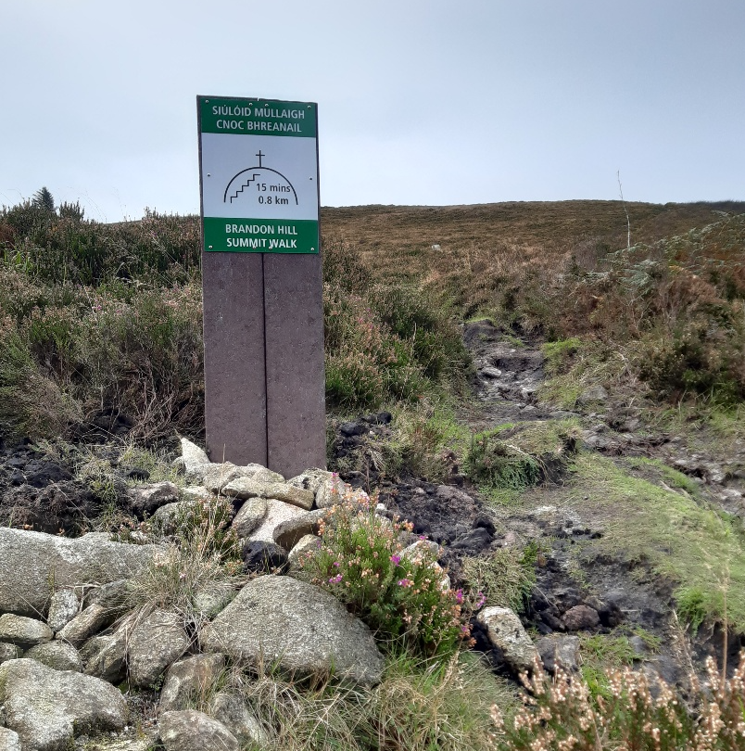
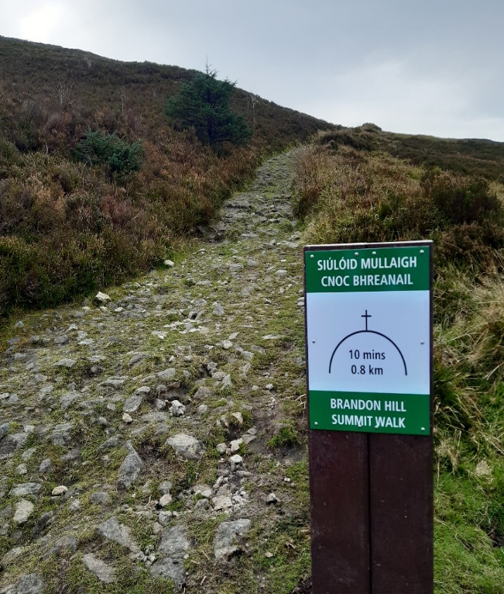
Outdoor Recreational Instructure Scheme - Measure 1 – Brandon Hill Summit Walk

Slide 7
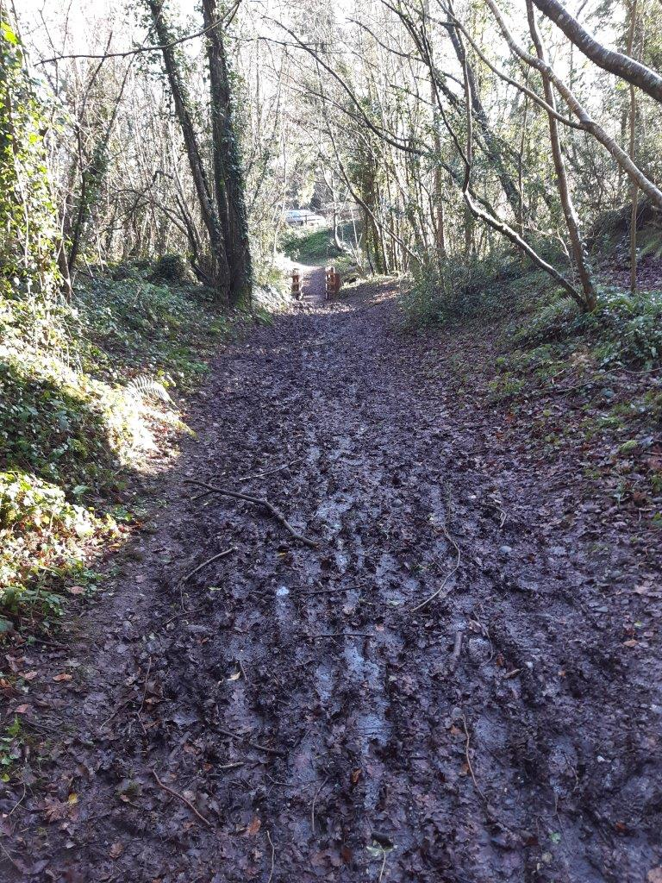
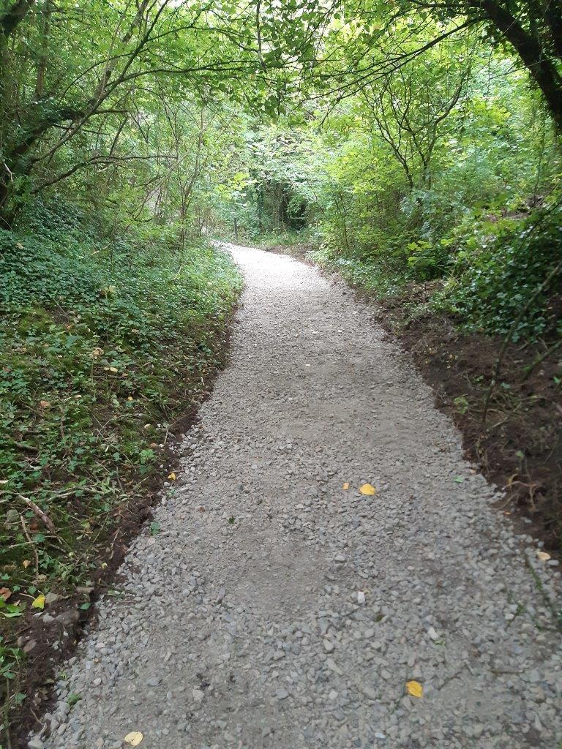
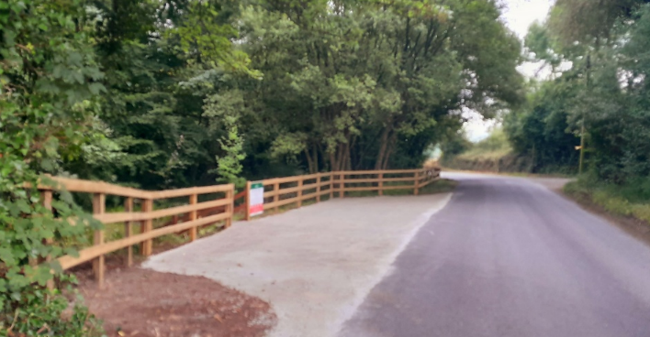
Outdoor Recreational Instructure Scheme - Measure 1 – Freshford Loop Walk

Slide 8
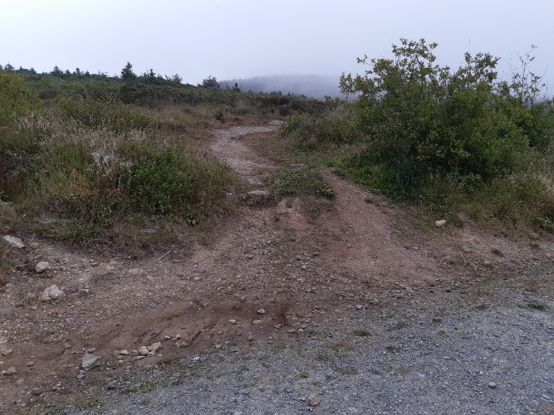
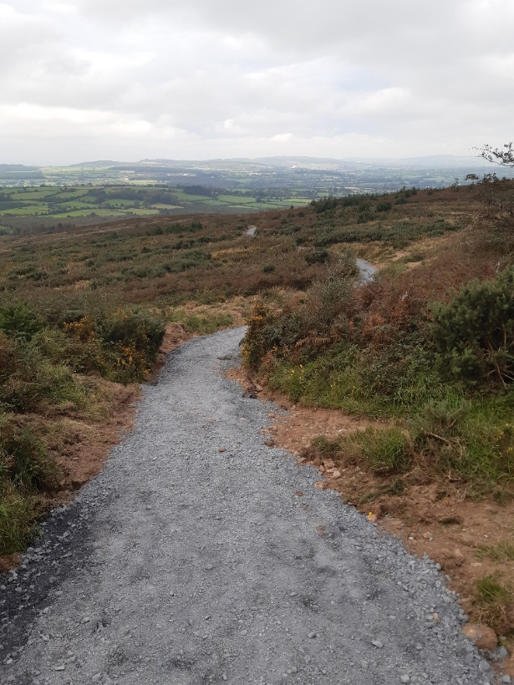
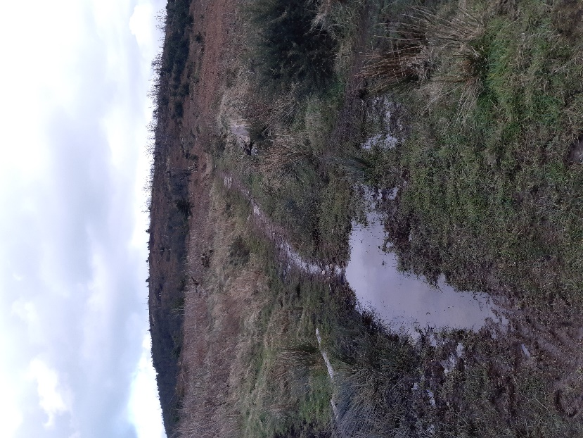
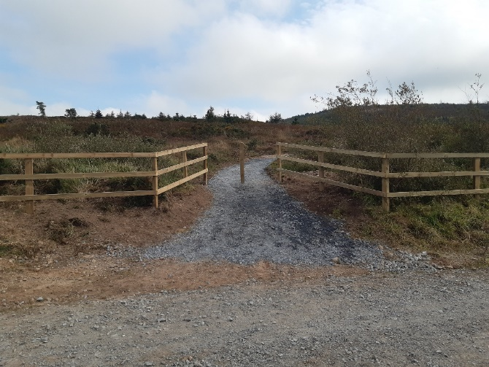
Outdoor Recreational Instructure Scheme - Measure 1 – Tory Hill

Slide 9
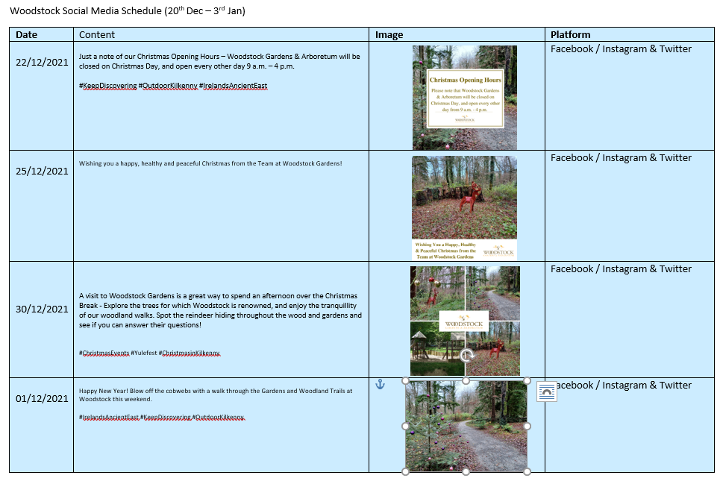
Outdoor Recreational Instructure Scheme - M1 – Woodstock Marketing & Promotion

Slide 10
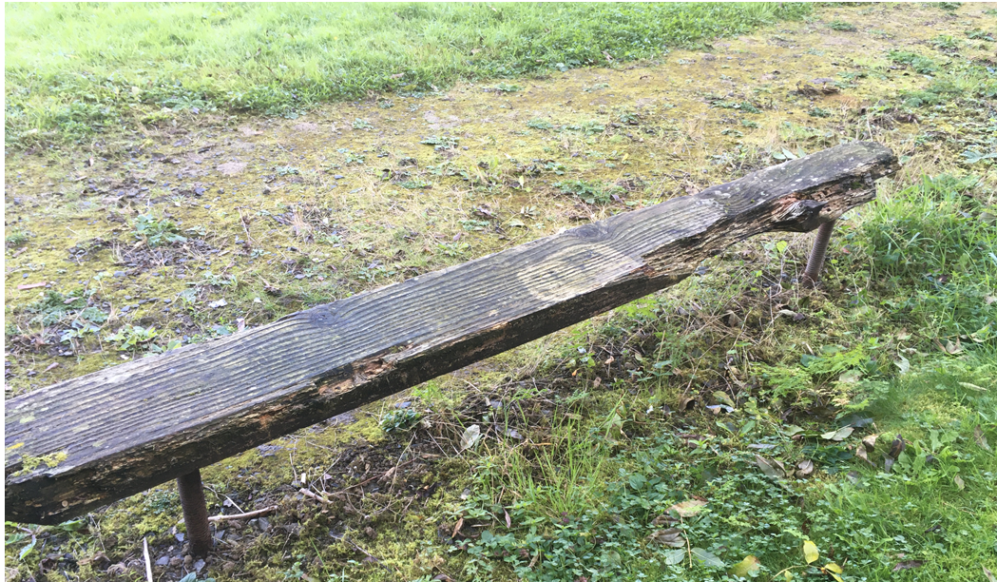
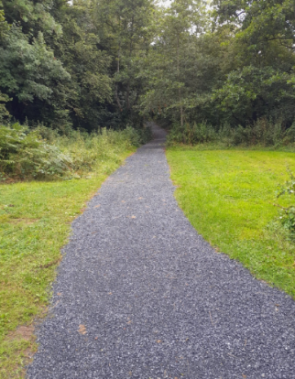
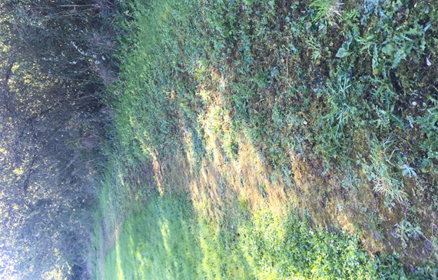
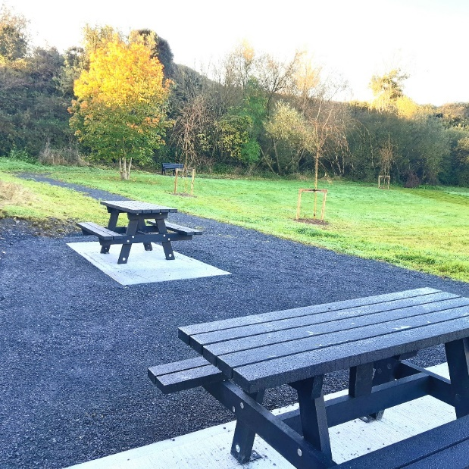
Outdoor Recreational Instructure Scheme -Measure 1 – Goresbridge - Cois Bearbha Riverside Looped Walk Upgrade

Slide 11
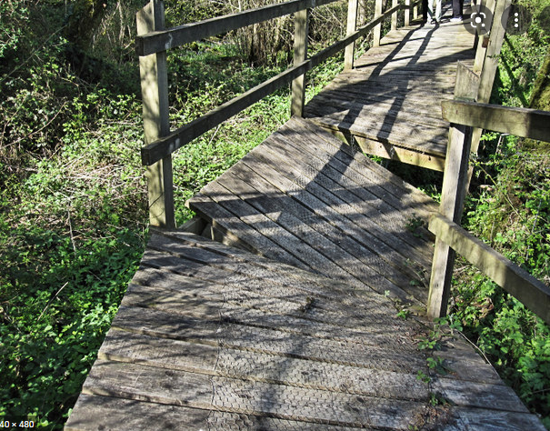
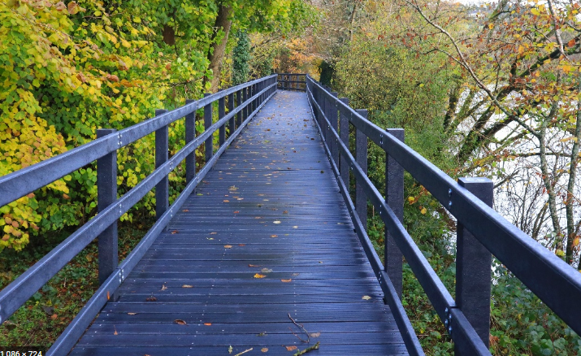
Outdoor Recreational Instructure Scheme - Measure 2 – Silaire Wood

Slide 12
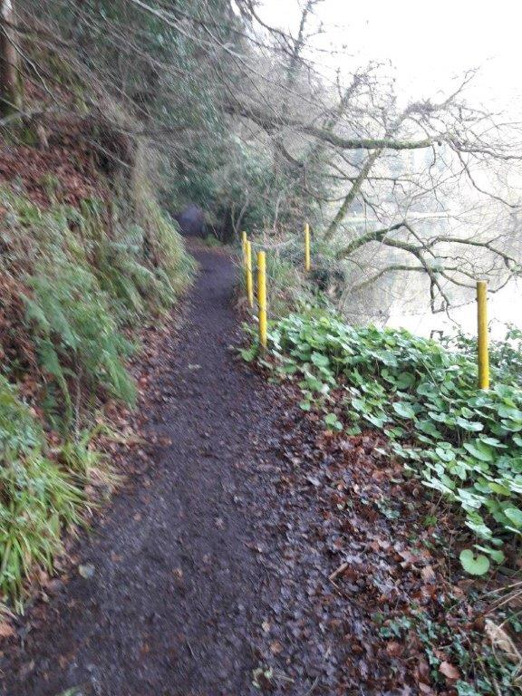
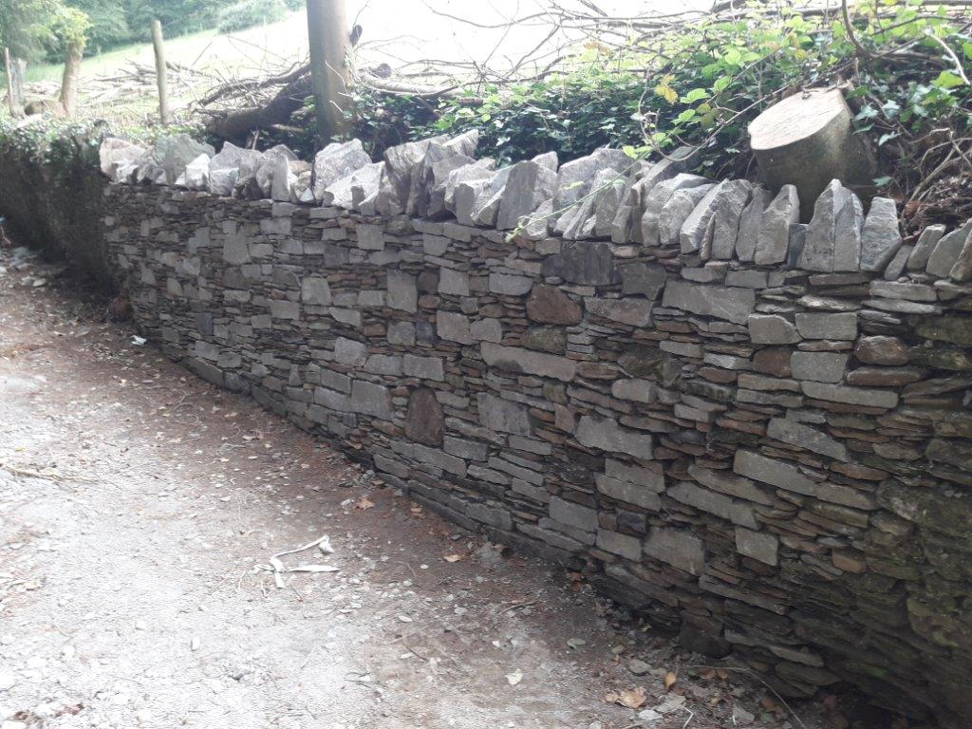
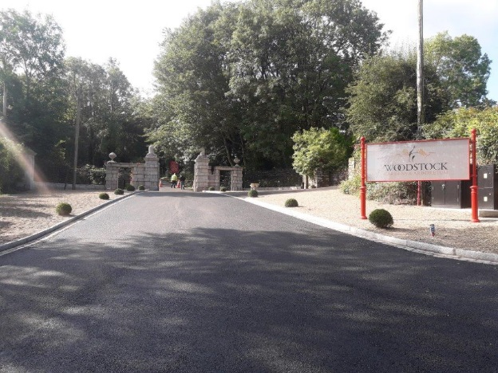
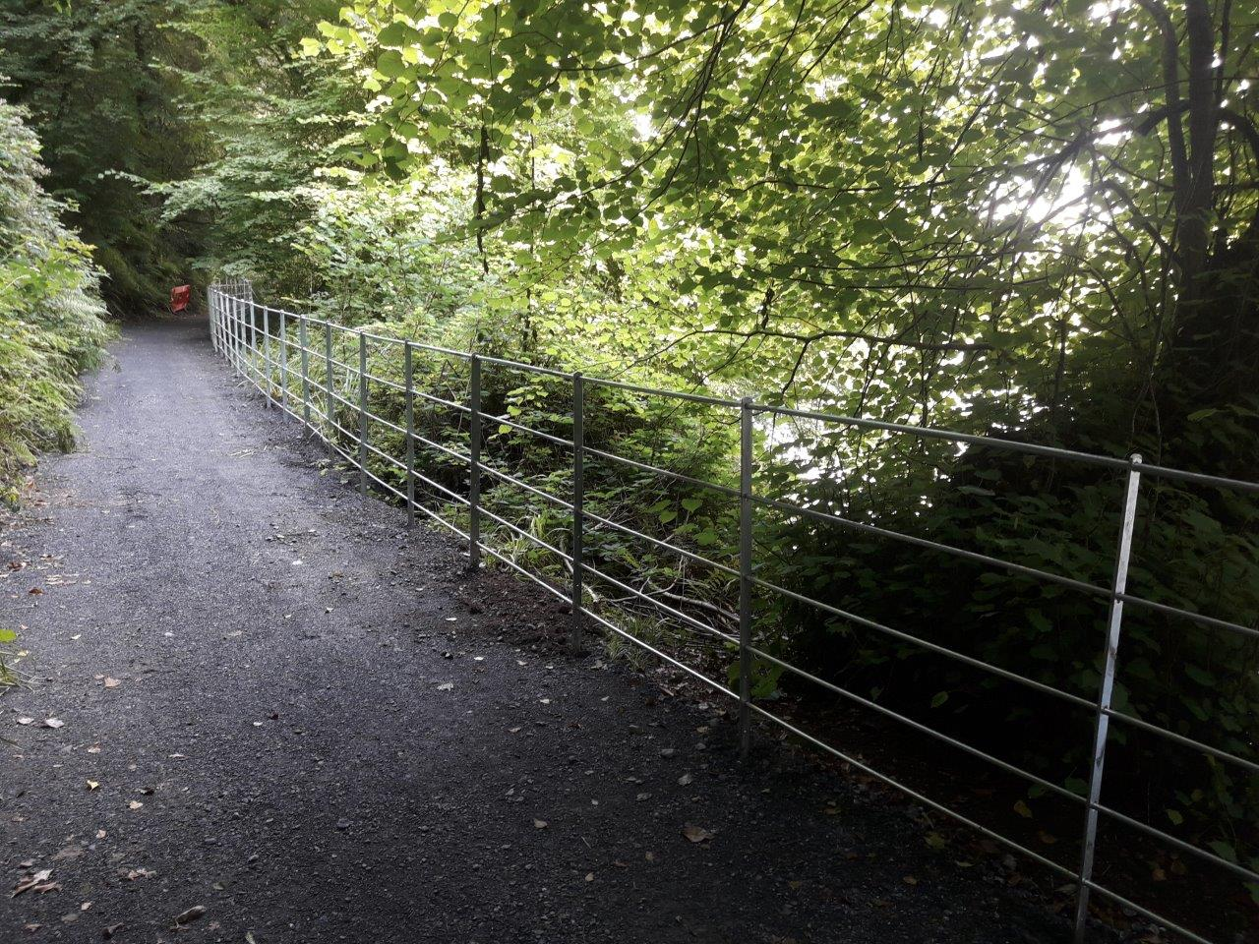
Outdoor Recreational Instructure Scheme - Measure 3 - Woodstock Estate 2018/19

Slide 13
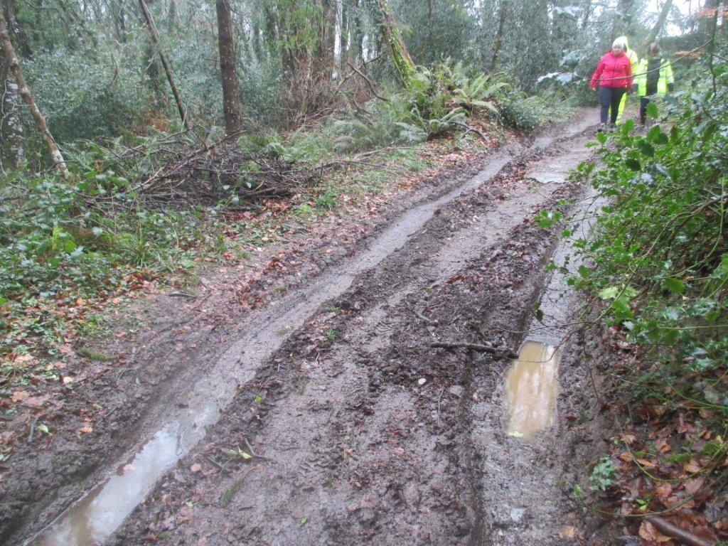
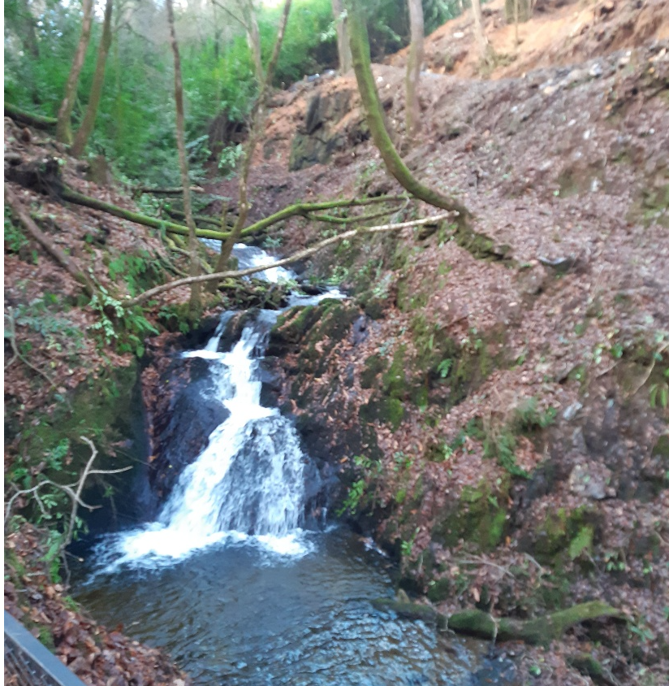
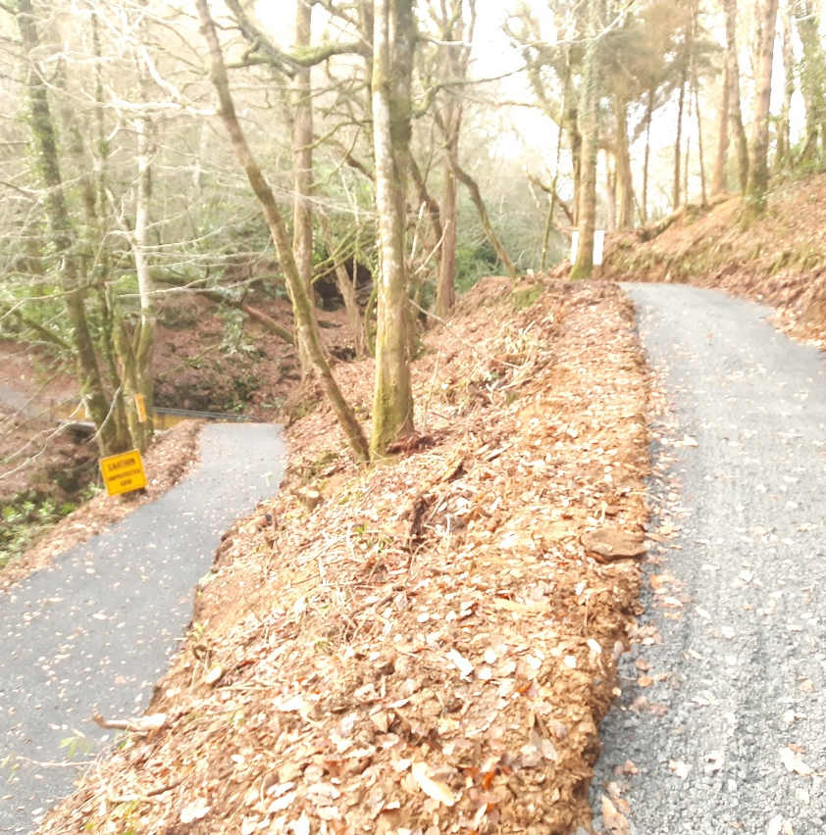
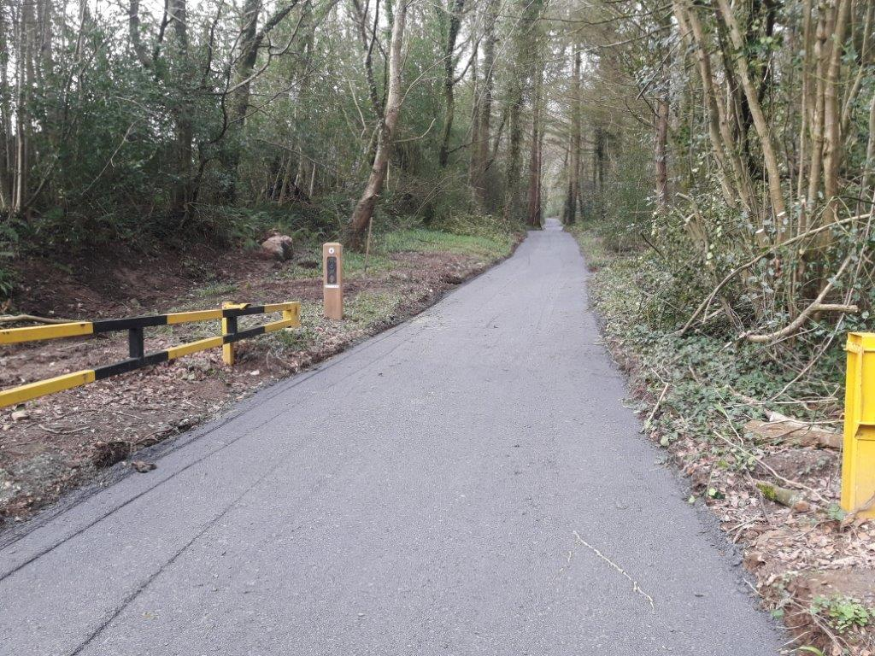
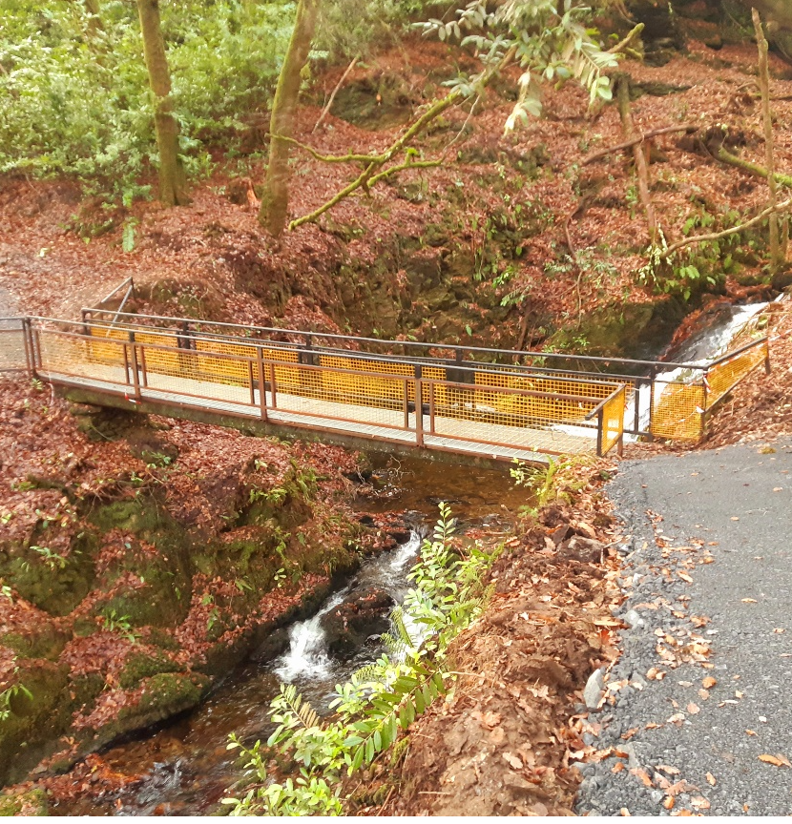
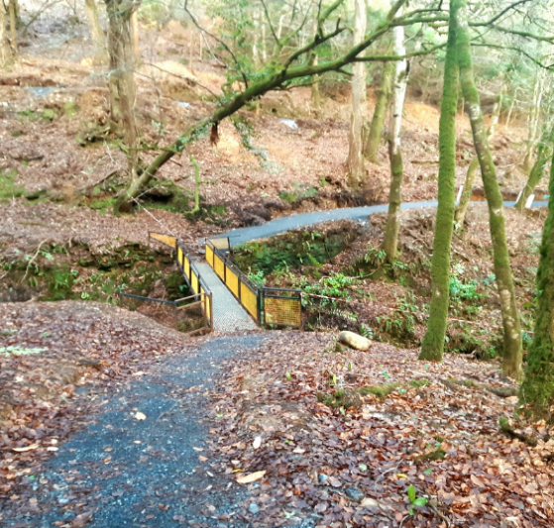
Outdoor Recreational Instructure Scheme - Measure 2 - Woodstock Estate 2020/21

Slide 14
Partnership Projects – LEADER Programme 2020
Silaire Wood Carpark & Signage Enhancement Scheme
Abbey Hall Recreational Area Enhancement Scheme
Graig Men's Shed (GMS)
Graig Outdoor Activity Hub - Access Rd Design
Graig Outdoor Activity Hub - Access Rd - Construction
Graig 2no. Pedestrian Bridges over the River Barrow Feasibility Study
South East Greenway - Connectivity to Glenmore and Sileverue
Total Investment: c.€930,000

Slide 15
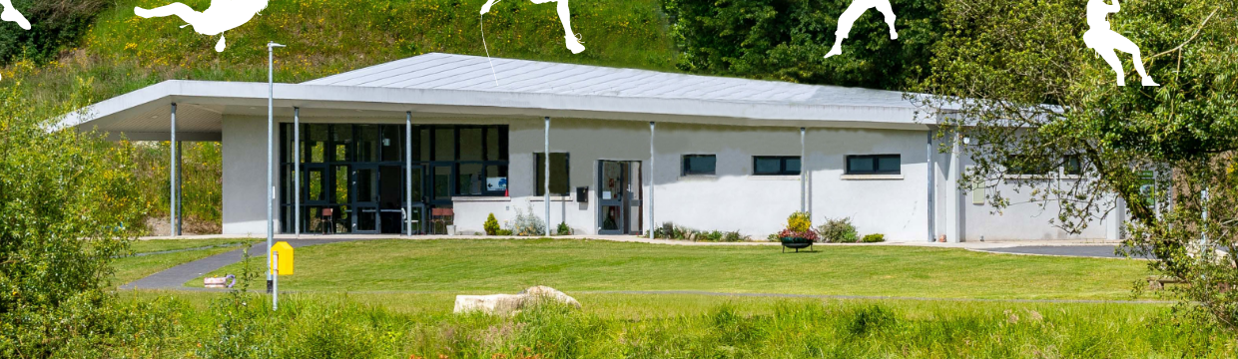
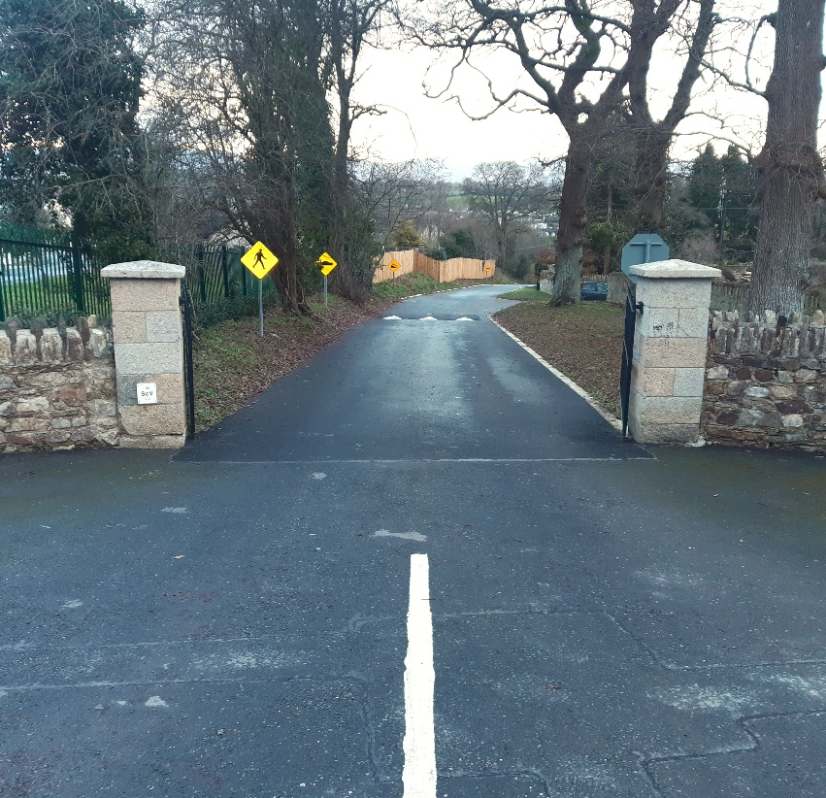
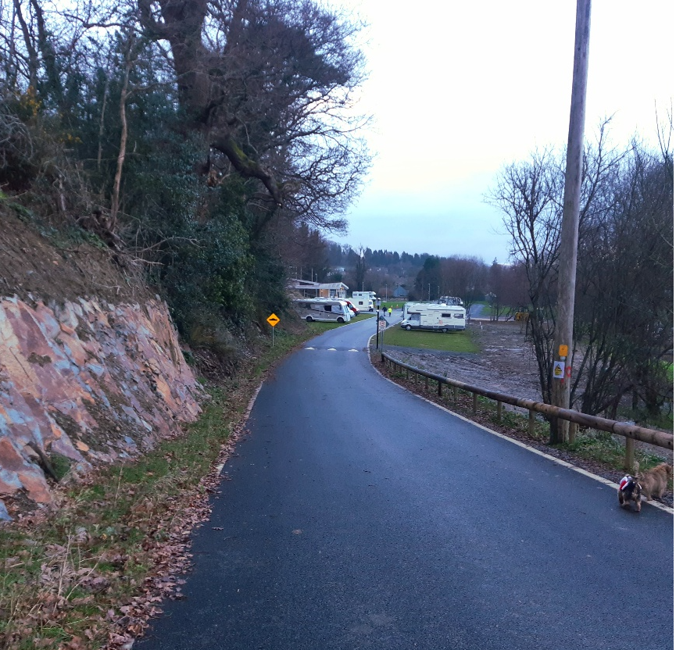
Partnership Projects
Barrow Valley Activity Hub

Slide 16
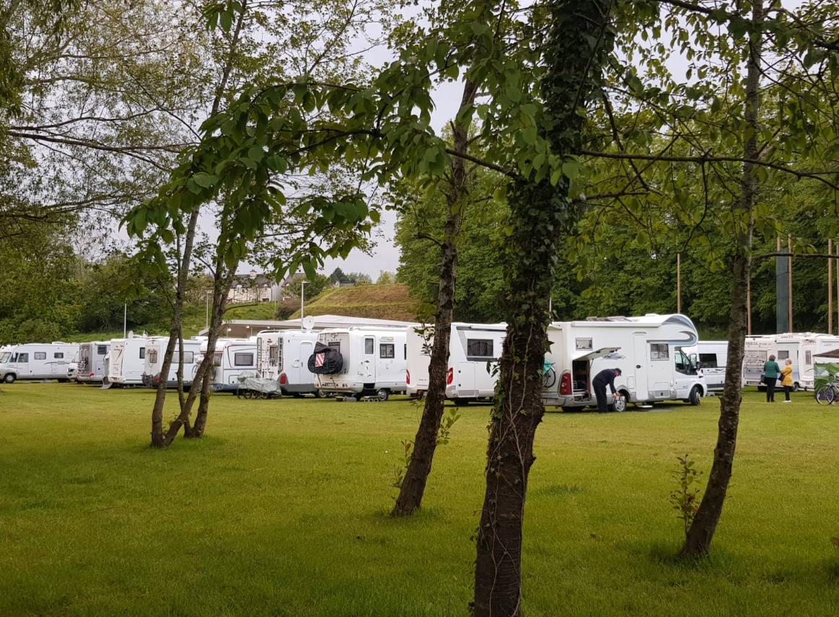
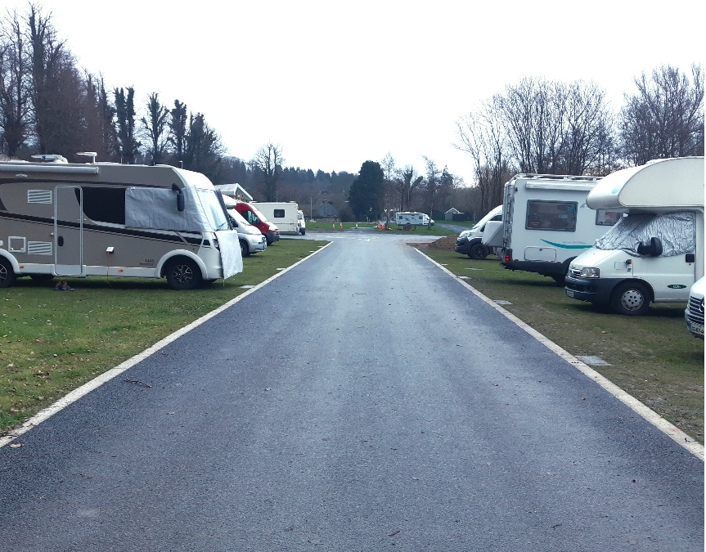
Partnership Projects
Barrow Valley Activity Hub

Slide 17
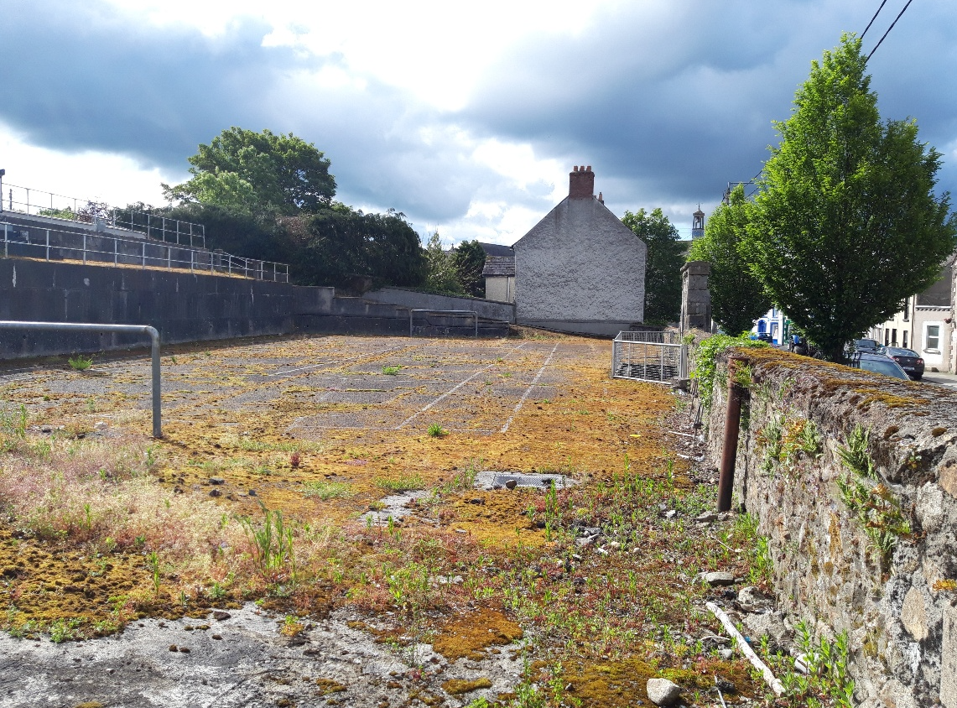
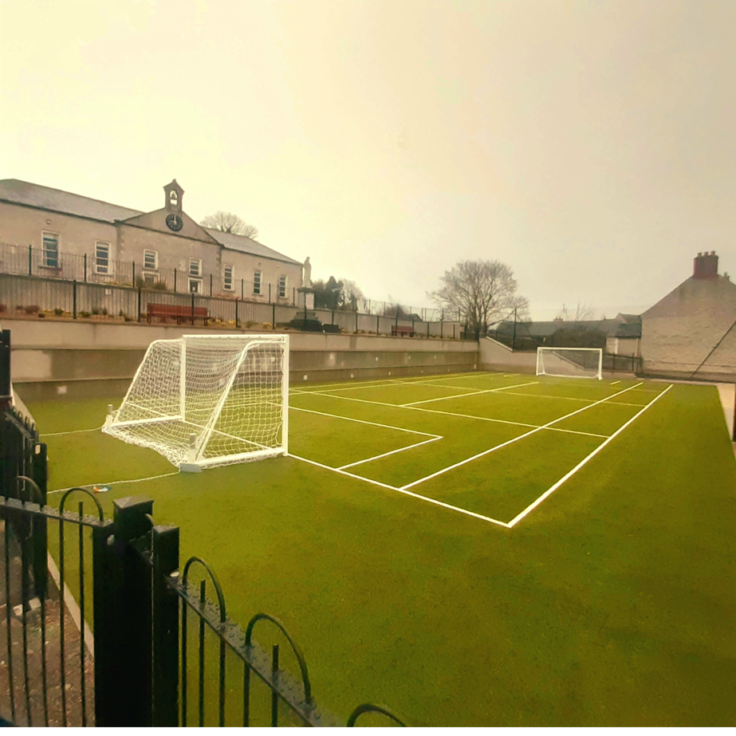
Partnership Projects
Abbey Hall Recreational Area Enhancement Scheme
Before
After

Slide 18
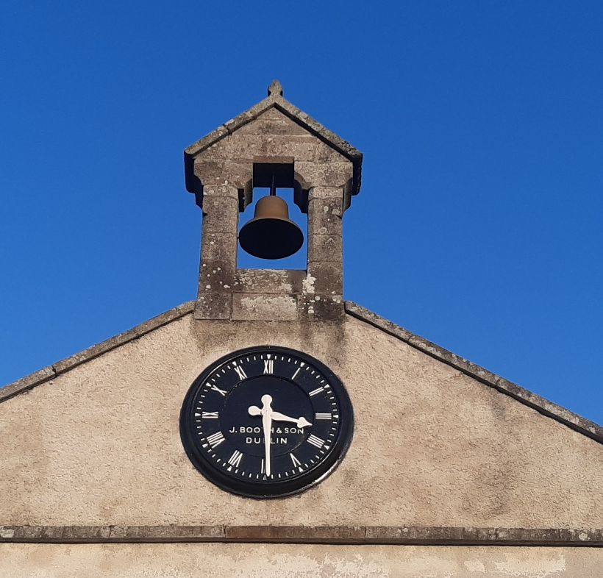
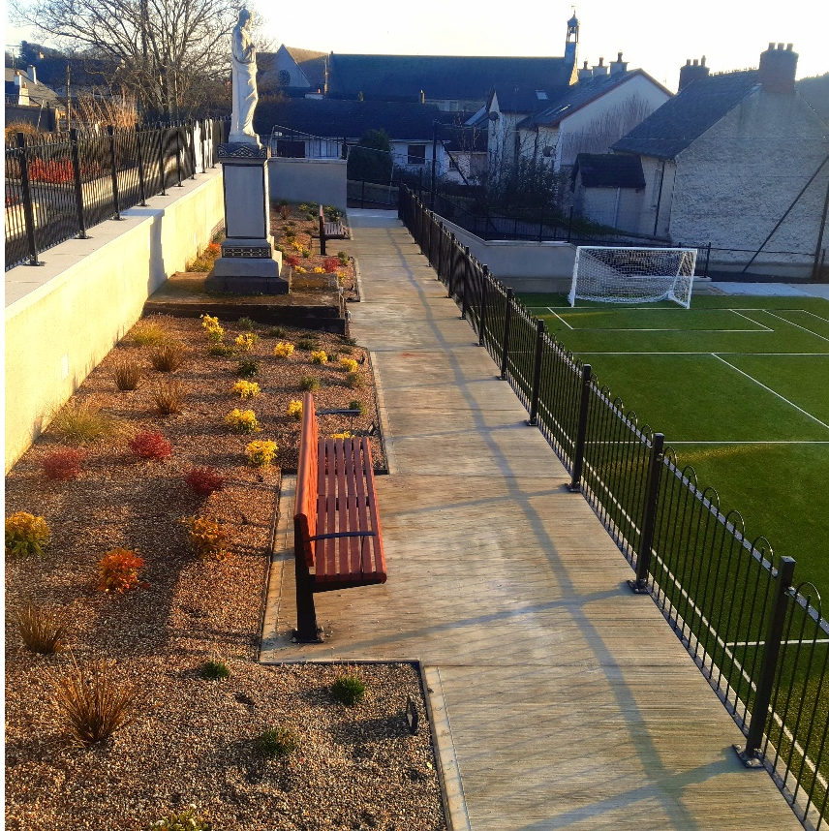
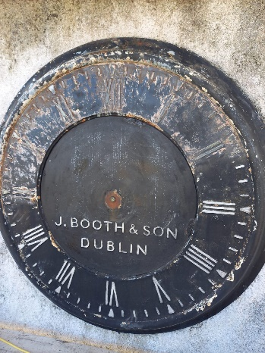
Partnership Projects
Abbey Hall Recreational Area Enhancement Scheme

Slide 19
Partnership Projects – LEADER Programme 2021-2023
Bennettsbridge Riverside Amenity Area - Feasibility and Design Option Report
Woodstock – Link to SE Greenway - Route Options Report
Bennettsbridge Riverside Amenity Area - Feasibility and Design Option Report
Slieverue Recreational Amenity Area
Goresbridge Riverside Amenity Area - Feasibility Options Report
Callan Heritage Trail
Nore Valley Link - Bennettsbridge – Thomastown - Route Options Report
Callan Heritage Trail
Estimated value: c.€327,000

Slide 20
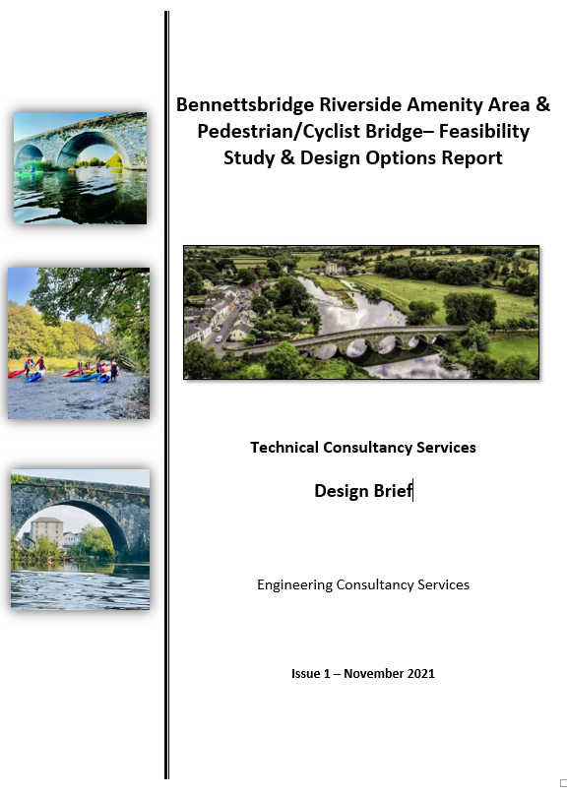
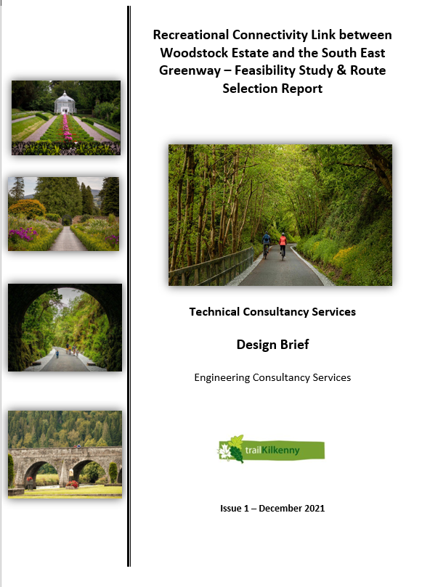
Partnership Projects – LEADER Programme 2021-2023

Slide 21
Partnership Projects – LEADER Programme 2021-2023
Goresbridge Riverside Amenity Area - Feasibility Options Report
  Local with local committee
  Assess existing and potential tourism offering of the area
  Develop tourism and economy
  Expression of Interest submitted and approved
  Consultancy Service Brief will tendered Q2/3 2022..
Slieverue Linear Park
  Strong and active local committee
  Build-on last years Town & Village Renewal
  Expression of Interest submitted and approved
  Local consultation advancing
  Subject to outcome of AA Screening IT IS expected construction prices will be sought Q2/3 to allow project advance to final approval stage.

Slide 22
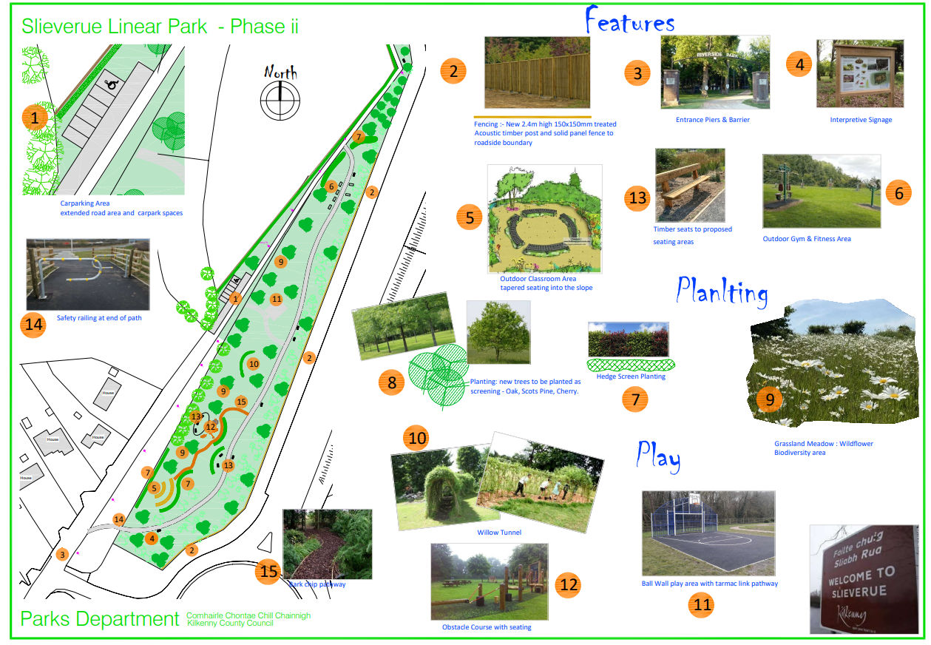
Partnership Projects – LEADER Programme 2021-2023 – Slieverue Linear Park

Slide 23
Partnership Projects – LEADER Programme 2021-2023
Nore Valley Link - Bennettsbridge – Thomastown
  Expression of Interest submitted and approved
  Route Options Report (Both side of river)
  Tender for Constancy Services Qtr1
Callan Heritage Trail
  Engage specialists to develop trail and interpretative signage, plus possible audio trail / augmented reality elements
  South to North
    Famine Graveyard - Workhouse - Parish Church - St. Mary’s Abbey - Skerry’s Castle - Marca Hall, Friary, Augustinian Abbey – The Moat, Gregory's House and Walled Garden, Edmund Rice Heritage Centre.
  Audit of existing signage

Slide 24
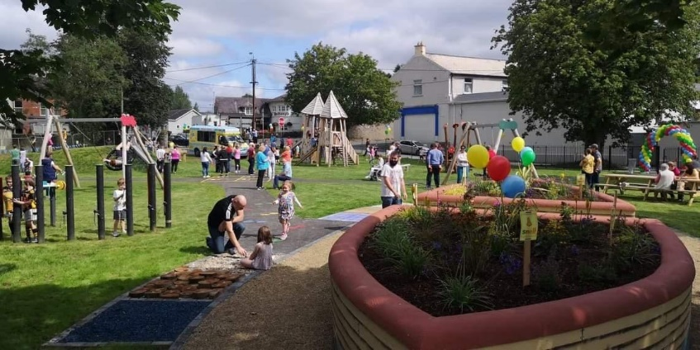
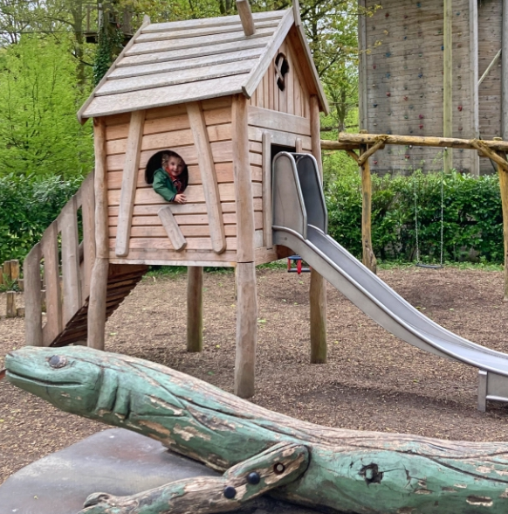
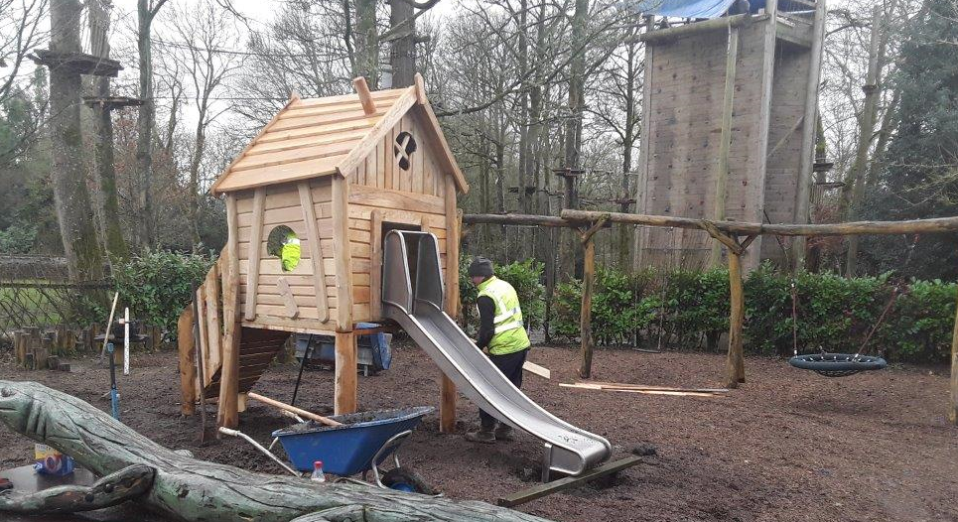
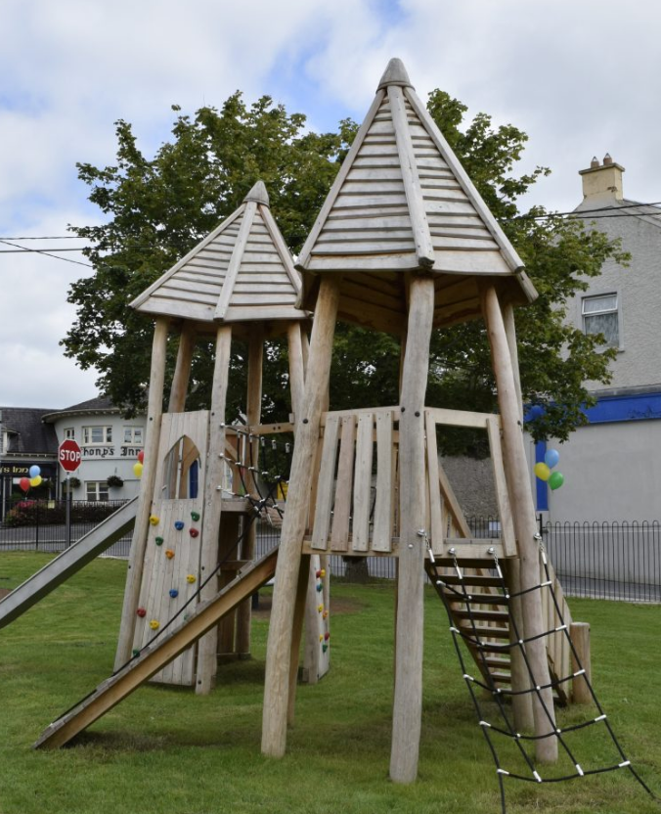
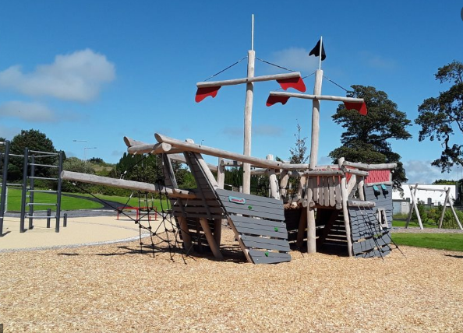
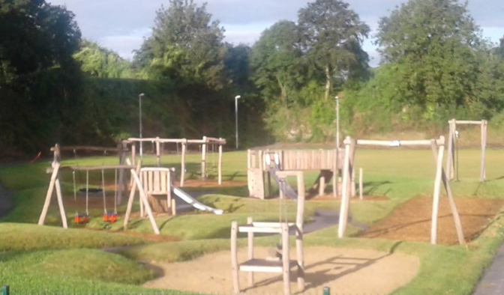
Playgrounds
31 Playgrounds
Investment cost just over c.€2.8m
Typical lifetime for playgrounds is estimated to be between 10 and 15 years.
6 of 31 – 15 years or older
8 of 31 - 10 - 15 year old

Slide 25
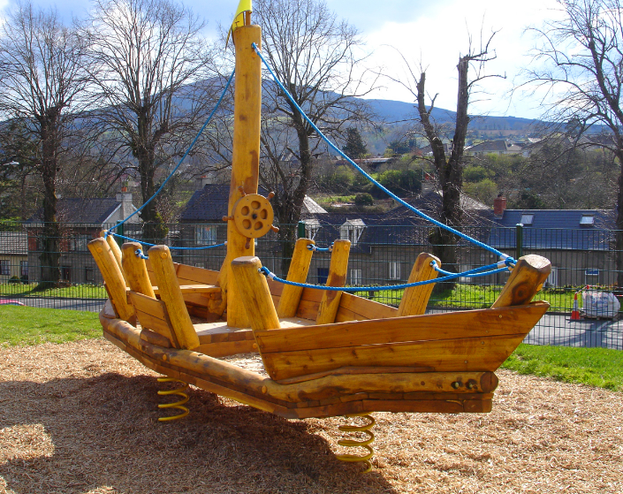
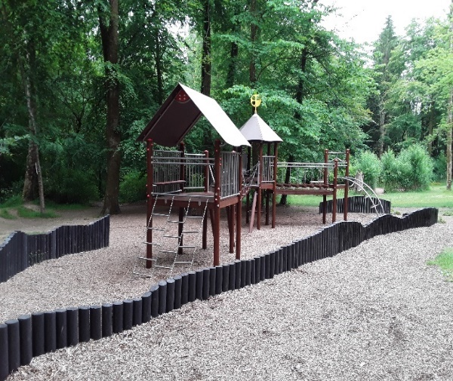
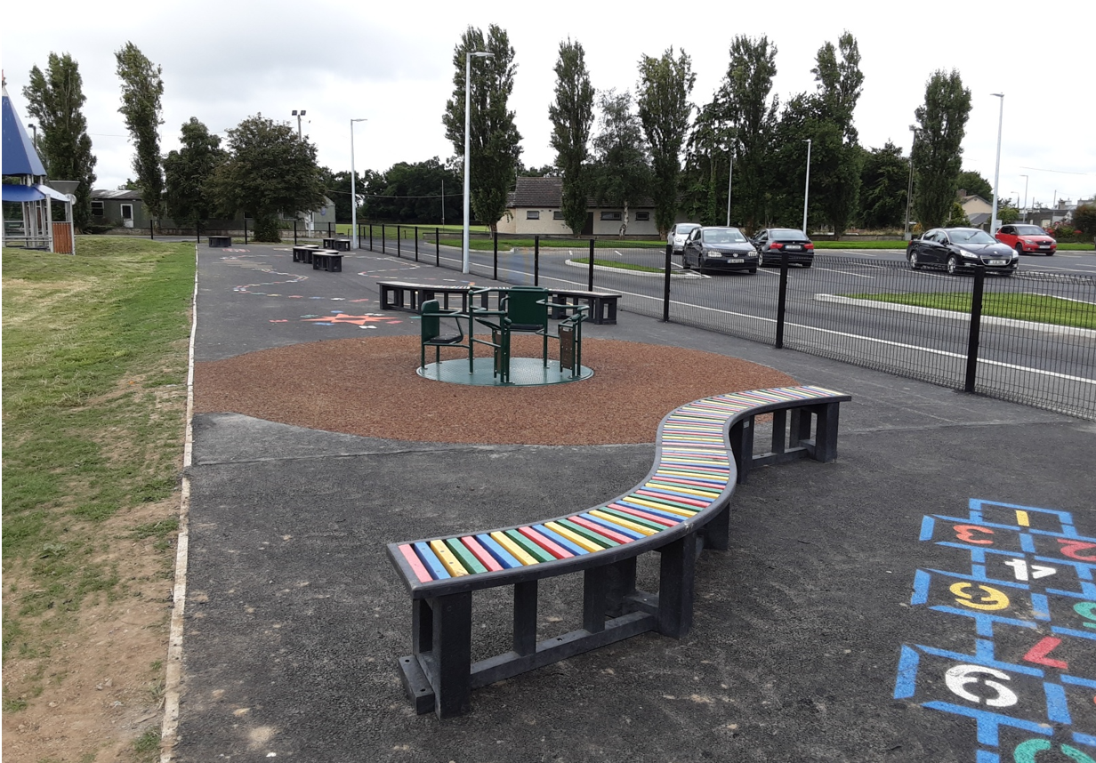



Playgrounds
865k maintenance budget provided for last 10 years.
Insufficient to maintain current level of presentation.
20% of play equipment is close to or at end of life
Replacement cost c.€600k

Slide 26
Thank You

