Slide 1
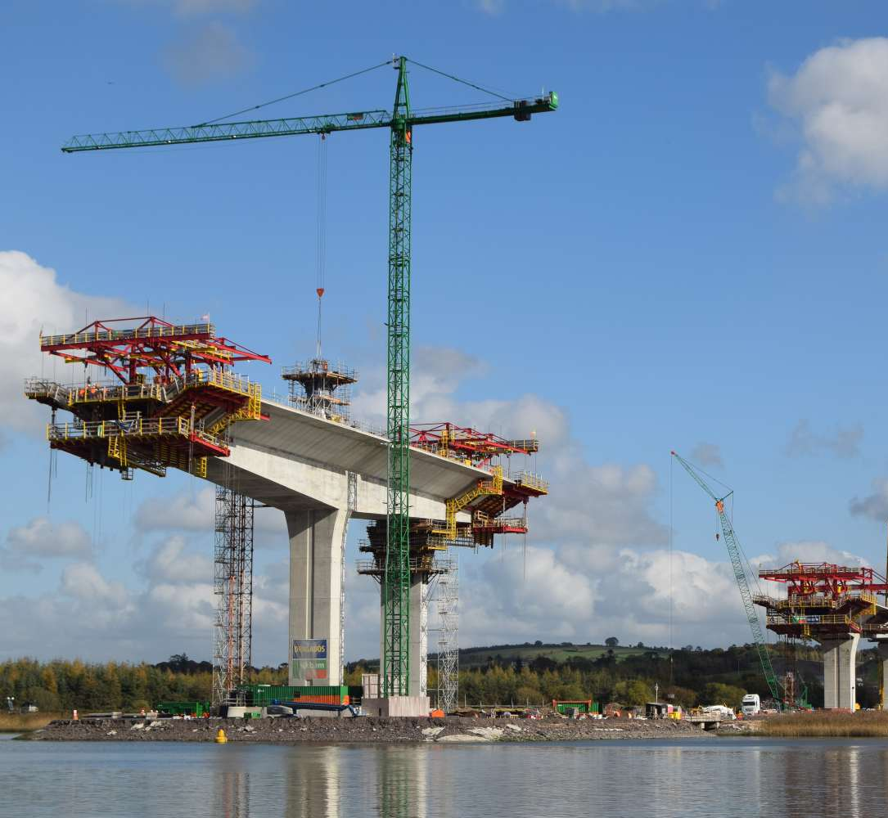

N25 New Ross Bypass PPP Project
Sean Dobbs
Project Liaison Officer
Kilkenny County Council
November 2018

Slide 2
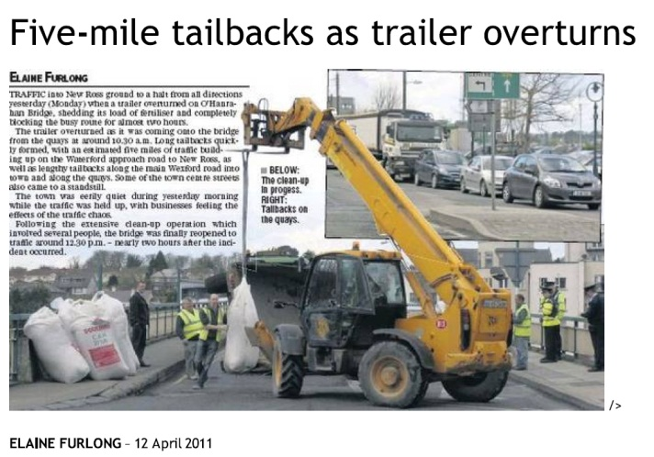
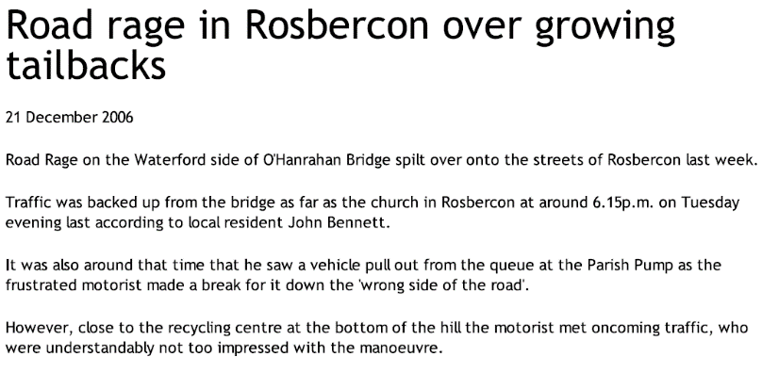
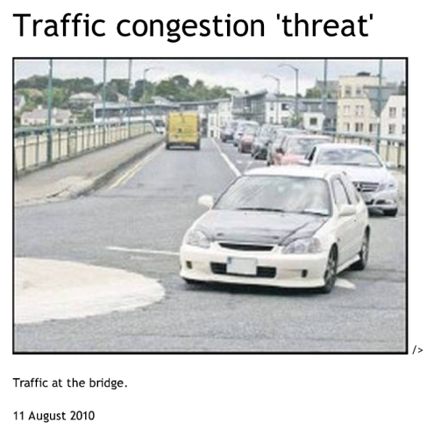

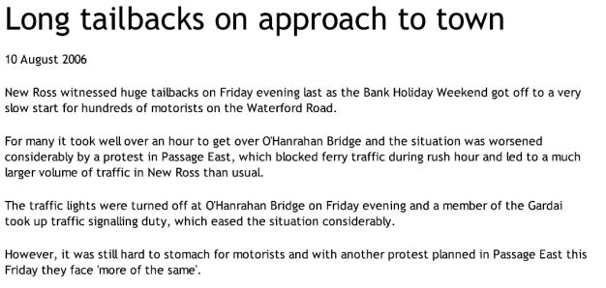
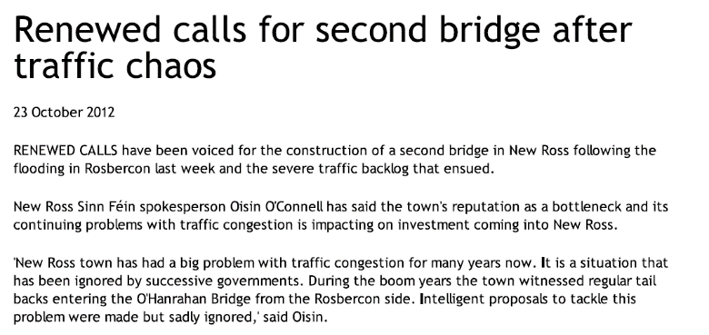
New Ross Bypass PPP Scheme
Why?
Traffic – significant delays common especially at peak times
Amenity – improvements to public spaces
  Network resilience - In the event of O’Hanrahan Bridge closure, significant diversion required via R700, Inistioge Bridge and Ferry Bridge

Slide 3
New Ross Bypass PPP Scheme
Project Timeline:
1993 – Wexford Co. Development Plan
1994 – Kilkenny Co. Development Plan
1998 – NRA National Roads Needs Study
2002 - Route Selection Report published
2005 - 2006 – Bridge Options Report
2006 - 2007 – Preliminary Design Report
2007 – Application to An Bord Pleanála
2008 – Scheme Approval
2009 – New Ross Bypass combined with M11 Enniscorthy as combined PPP Scheme
2013 – New Ross Bypass to be progressed separately
2014 – Project Tendered
2015 – Preferred Bidder Identified as BAM/Iridium
2016 – PPP Contract Signed - January 2016
2019 – Construction Completion – 2019
2019 – 2044 – PPP Operation & Maintenance

Slide 4
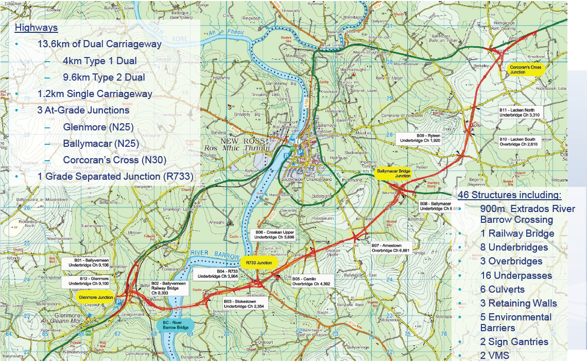
New Ross Bypass PPP Scheme

Slide 5
New Ross Bypass PPP Scheme
Barrow Bridge – Design Considerations
River Barrow
  River approx. 300m wide
  River Barrow Special Area of Conservation (SAC) - Pier 4 located in the River Barrow
  Levee and flood plain
  Port of New Ross
  Shipping channel – Requirement for 36m clearance above MHWS
  Topography / Ground Conditions
  Pink Rock
  Alluvial & Glacial Deposits

Slide 6
PPP Contract
New Ross Bypass PPP Scheme
Transport Infrastructure Ireland (TII) awarded the Public Private Partnership (PPP) Contract to a BAM Iridium consortium in January 2016.
The PPP Co’s contractor for the works is a Joint Venture between BAM Civil Ltd and Dragados Ireland Ltd (NRJV).
The road is programmed to be complete in 2019, after which the PPP Co. will continue to operate and maintain the road for a 25 year period.

Slide 7
Consultations with Local Authorities
New Ross Bypass PPP Scheme
Interfaces with public road network – permitted access routes, road crossing points, road sweeping & cleaning, road conditions etc.
Construction traffic management plans & speed limits for public roads
Road closures & temporary diversions
Design proposals for side roads
Planning & environmental consultations & applications
Consultations with elected representatives
Concerns & complaints from local residents

Slide 8
Public Liaison & Relations
New Ross Bypass PPP Scheme
Public Liaison Officer representing Wexford & Kilkenny Councils
Project website provides up to date information on current works, traffic management, upcoming works, contact details etc.
Quarterly project newsletter circulated in public buildings & local conveniences
Quarterly progress videos – see project website
Project 24 hour hotline number 1800 815 672
Consultations with elected representatives
Concerns & complaints from local residents

Slide 9
New Ross Bypass PPP Scheme
Thank You

