Slide 1
Kilkenny County Council
Meeting Housing Demand
October 2018

Slide 2
Projected Demand for Residential Development
RSES provides for target population increases by 2026 as follows:
County Kilkenny - projected to increase to c110,000 (or c11%);
Kilkenny City - projected to increase to c30,000 (or c12%).
CSO: Average Household Size in 2016 = 2.75 persons per Household, which equates to Projected Housing Demand of:
c400 new houses per annum required for County Kilkenny to meet projected population increases; with
c120 of these new houses per annum required in Kilkenny City.

Slide 3
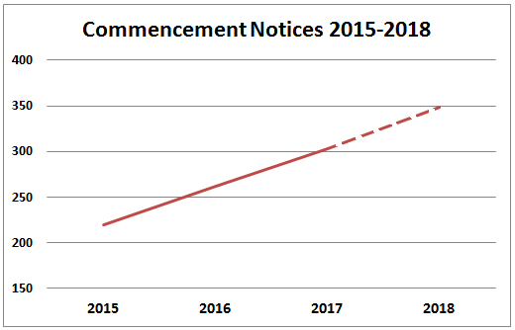
Commencement Notices Issued for Residential Development
Commencement Notices Issued in Co Kilkenny in last 3 years:
Year Number
2015: 220
2016: 262
2017: 303
2018 (YTD): 232*
*projected 348 for the year, which represents
an increase of 58% in number of commencement
notices 2015 - 2018.

Slide 4
Planning Permissions for for Residential Development
There are 34 planning permissions in situ for new multi-unit residential build developments currently in place in County Kilkenny accounting for almost 1,100 homes:
830 of these permitted units are located in Kilkenny City; and
211 are located throughout the rest of the county.
There are a further 11 planning applications for multi-unit residential build developments currently under consideration, accounting for a further 280 houses.

Slide 5
Local Infrastructure Housing Activation Fund (LIHAF)
LIHAF was introduced under Re-building Ireland Programme in an effort to address infrastructural deficit impeding housing delivery
Call for proposals issued by the Department in September 2016
Kilkenny had two successful applications for road infrastructure in the Western Environs, Kilkenny City and amenity provision in Ferrybank
Grant of 75% of construction cost for Western Environs –
€5.070m for connecting road from the Callan Road to the Circ Rd
and re-alignment of the Circular and Kilmanagh Roads
CPO in place and detailed design nearing completion
It is expected that road construction will commence Q4 2018
It is envisaged that housing and school will commence simultaneously
Affordable Housing

Slide 6
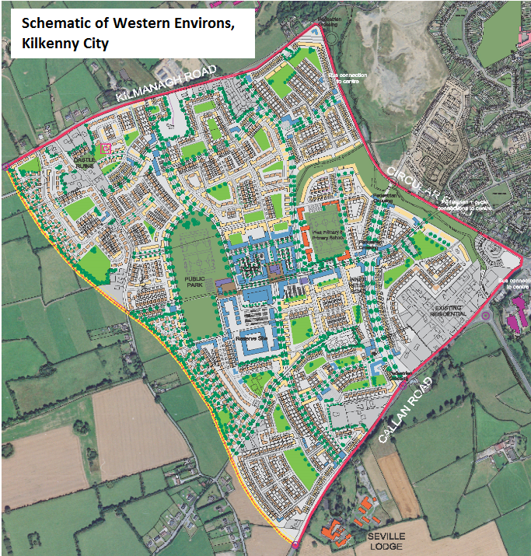

Slide 7
Rebuilding Ireland – An Action Plan for Housing and Homelessness 2016 – 2021 Pillar 2 - Accelerate Social Housing Replaces Housing Strategy 2015-2017 50,000 homes nationally by 2021 Dept Target KCC 2018/2021 = 599 2018 Target for Kilkenny = 133

Slide 8
Housing Demand 1st October 2018
Area |  | Approved Applicants | 1 Bedroom | 2 Bedroom | 3 Bedroom | 4 Bedroom
Kilkenny City & Environs | 59% | 1,229 | 471 | 478 | 241 | 39
Rest of County | 41% | 847 | 314 | 289 | 206 | 38
Total |  | 2,076 | 785 | 767 | 447 | 77
Net Need | 1,100 |  | 38% | 37% | 21% | 4%

Slide 9
Housing Stock October 2018
Kilkenny County Council | Total
LA Housing Stock | 2,300
RAS Units | 547
HAP Units | 872
Leasing Units | 146
Total stock available to the Council | 3,865
Rebuilding Ireland Target | 599
City | 353
County | 246
CAS Units = 700+

Slide 10
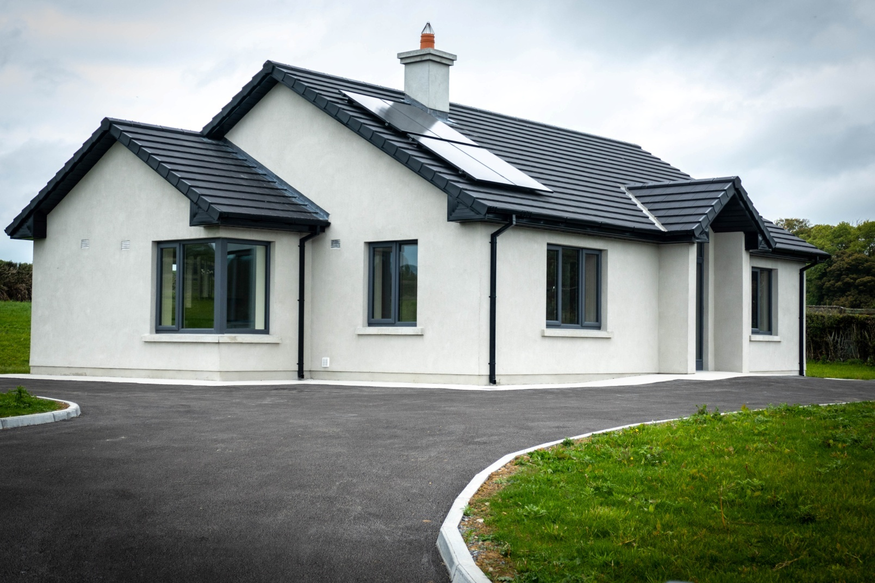
Kilkenny County Council – Completed 2018
9 Units, Abbeygate,Ferrybank
1 Rural Cottage, Barna, Woodsgift
2 Units at Hazelbrook, Newrath
4 Units, Smith’s Road, Ballyragget
5 Units Greensbridge House, KK
9 Units Side Road, Moneenroe
4 Units, St. Catherine’s GHS, Wetlands
34+ homes

Slide 11
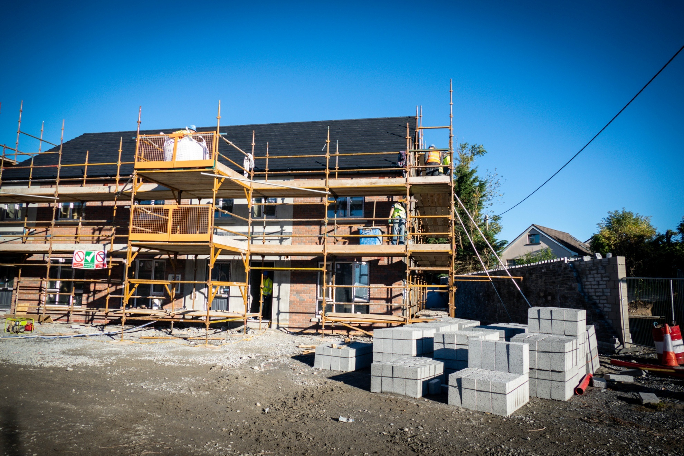
Kilkenny County Council – Under Construction
54 Units, Ballybough St, KK
27 Units, Walkin St, KK
18 units Togher Way, Urlingford
38 Units, Bolton Callan
9 - 12 units, Ogenty, Gowran
12 units (Wing 52), Good Shepherd, KK
6 units, Garringreen, KK
221+ homes

Slide 12
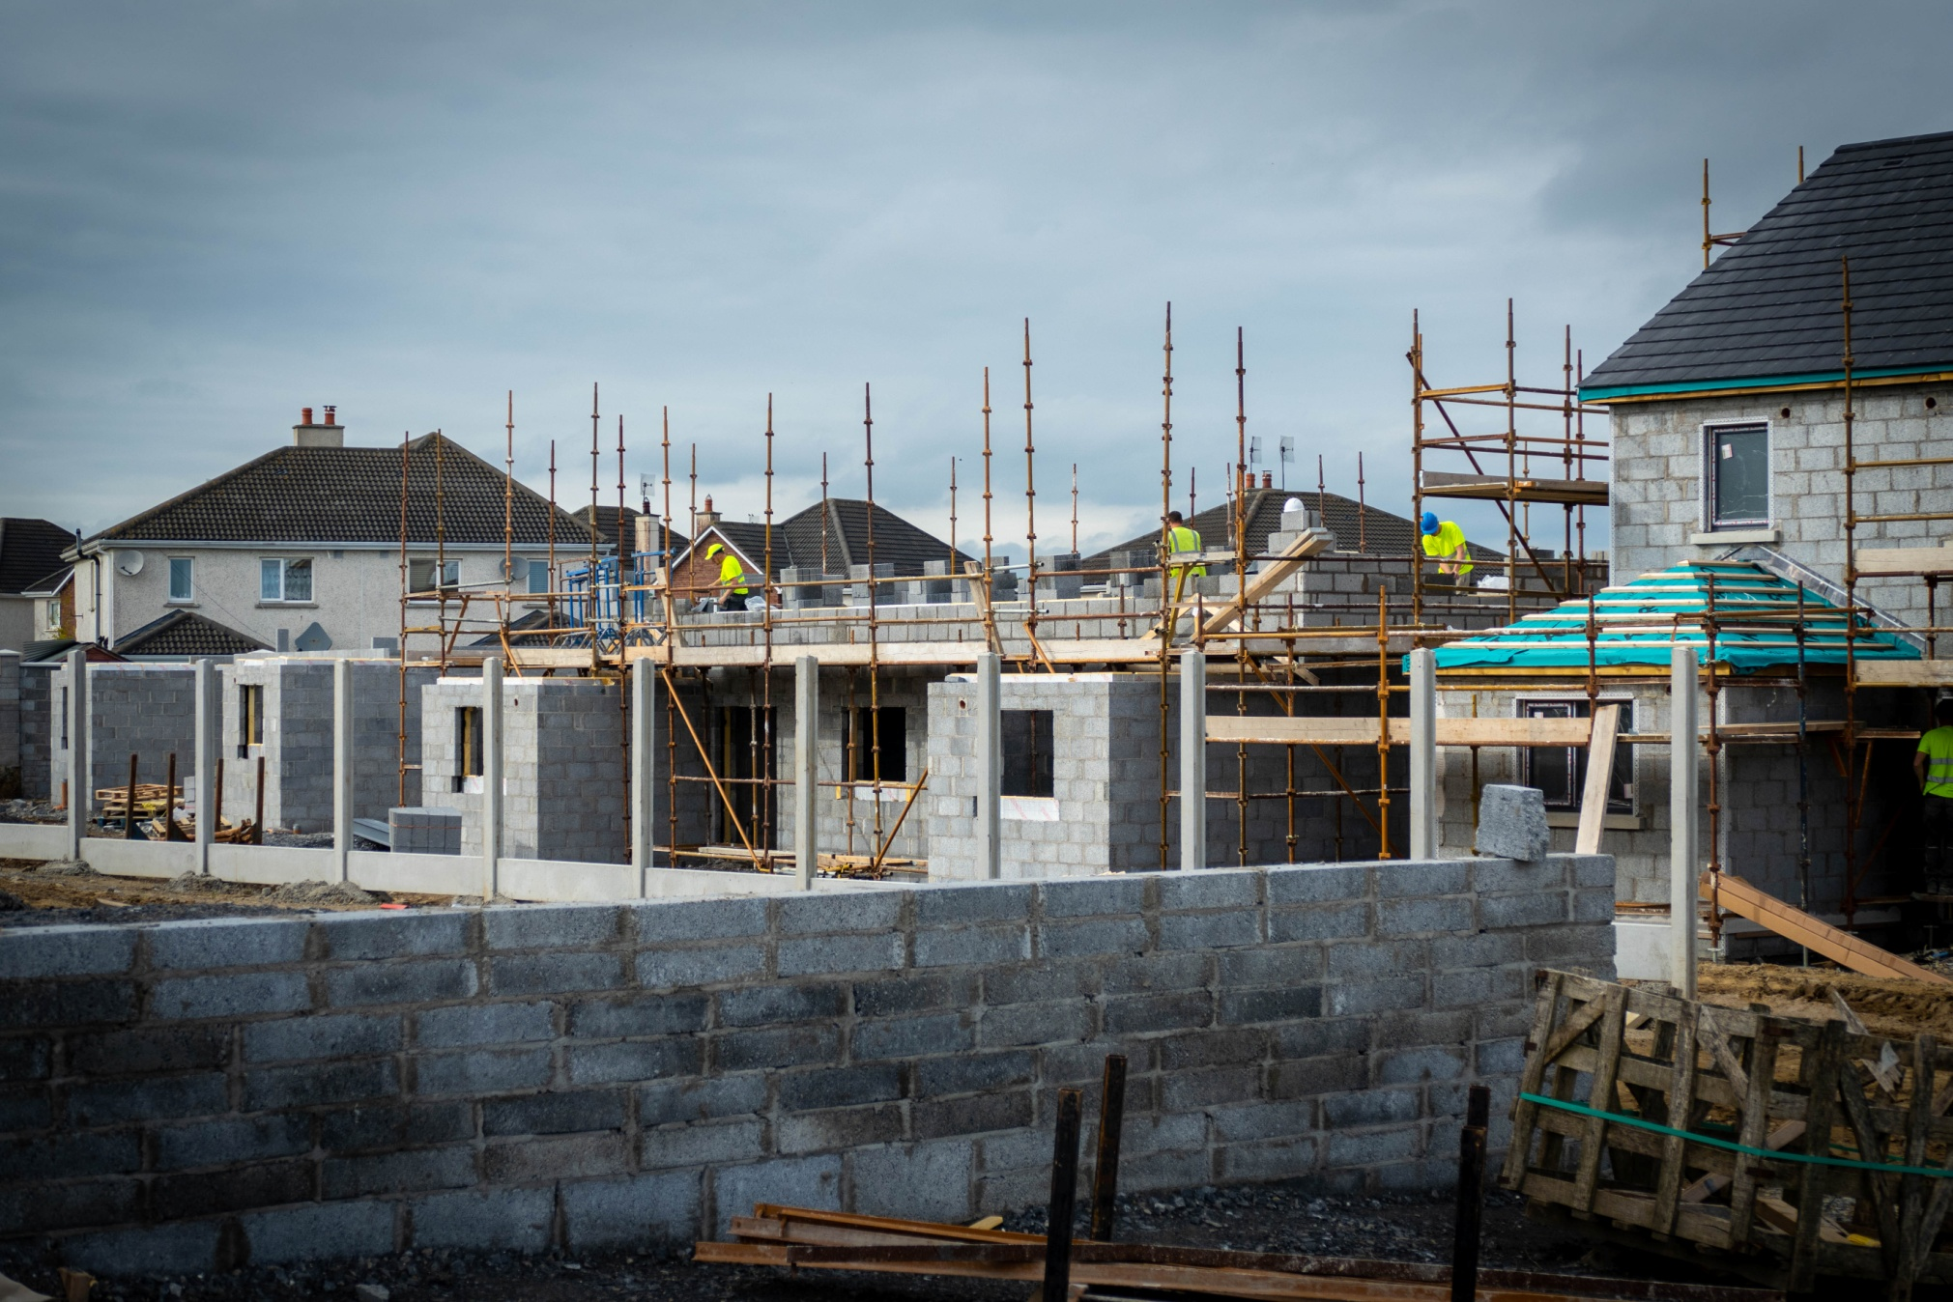
Kilkenny County Council – Under Construction
15 units, Callan Manor, Callan
10 units, Castlehyde,Rosbercon
2 units, O’Loughlin rd, KK
16 units, Friary Walk Callan
1 House at St Mary’s GHS
6 units, Mooncoin
4 Love Lane, Castlecomer
221+ homes

Slide 13
Kilkenny County Council – Housing Capital Planning / Design / Tender Stage
357+ Units
90 units at Crokershill, KK, Planning Stage
18 units at Broguemaker, KK – Part 8 to be advertised shortly
33 units at Donaguile, Castlecomer, Tenders received and under review
4 Units (1 group home) at Blackstaff, Callan - Tenders received and under review
22 units at Station Rd, Ballyragget. Tender docs being finalised. Tender Q4 2018.
17 units at Piltown. Tenders received and under review
50 Units at Nuncio Road, KK – commencement to start

Slide 14
Kilkenny County Council – Housing Capital Other Projects
8 units at Togher Way, Urlingford – Possible turnkey project
4 units (1 group home) at Cloghabrody, Thomastown – Part 8 granted, detailed design underway
6 units at Golf Links Rd, Kilkenny City. Planning drawings being prepared
7 units at Kilkenny Road, Freshford – site appraisal underway
10 houses at Ladyswell, Thomastown – site appraisal underway
40 Units at Margaretsfield, Callan Road – AHB seeking funding approval
48 Units under CAS scheme by various AHB’s
357+ Units

Slide 15
Acquisitions 2018
Local Authority
17 units – sales completed to date
15 units – sales agreed
AHB (CAS)
30 units – sales completed to date
39 units – sales agreed
AHB (CALF)
3 units – sales completed to date
10 units – sales agreed
101 homes

Slide 16
Rebuilding Ireland 2018 Summary
Scheme of Delivery | Units
Acquisitions (LA/AHB)
-Completed | 50
-Sales Agreed | 64
Construction
-Completed | 34
-Under Construction | 221
-Planning, Design, Tender stage KCC | 357
Sub-Total | 726
-Site Appraisals (15) | 121+
Total | 847
Rebuilding Ireland 2018 – 2021
Target 18/21 = 599
Target 2018 = 133
2018 Delivery = 185
Construction = 105
Acquisition = 80

Slide 17
Homelessness
Current Average of 30 homeless and at risk of homelessness presentations each month
The Council in collaboration with Voluntary Bodies provide:
24 units at Good Shepherd Centre
8 transitional units at Brother Thomas Place
1 family unit at the Lodge, GSC
8 Rooms in local Hotel
7 rooms in Amber Women’s Refuge Centre
27 Community houses/apartments by GSC and Focus Irl
5 units short term accommodation at Greensbridge for women
New:- Placefinder Role
80+ Units

Slide 18
Mortgage to Rent (MTR)
Government Initiative to keep people in Homes
Households that have unsustainable mortgages
Borrower surrenders to the lender, who sells to AHB
AHB rents to the borrower who becomes a social housing tenant
Tenant pays an income based differential rent
Tenant can buy back after 5 years
Certain criteria to be met e.g. Negative Equity, Valuation, Assets

Slide 19
Mortgage to Rent (MTR)
Model 2. Voluntary
10 successful cases to date
21 applications at various stages
Cases take average 12 – 18 months
AHB’s who administer the scheme
Icare AHB
Tuath
Cluid
Oaklee
Respond
Home for Life

Slide 20
Repair and Leasing Scheme (RLS)
Assists owners to bring vacant properties back into use –Feb 17
RLS pays for repairs upfront in return for unit leased to LA/AHB for 10 years or more
Cost of repairs repaid by owner by offsetting cost against rent due (80%) to the owner
Property must be vacant > 12mts
Must be a social housing demand in area
Minimum lease 5 years up to a max of 20yrs
Landlord is either LA/AHB –Max support €40k

Slide 21
Rebuilding Ireland Home Loan
New Home Loan for first time borrowers
Operational 1st February 2018
Borrow up to 90% of market value
Deposit 10% - was 3%
Max Market property value €250k–was €200k
2% fixed for up to 25 years
2.25% fixed for up to 30 years
2.30% variable for up to 30 years
16 Loans Approved in 2018 - €1.8ml
21 Loans Paid out in 2018 to date - €2.3ml

Slide 22
Vacant Homes Action Plan Progress(1)
1. Vacant Homes Officer Appointed March 2018
Initial vacancy assessment desktop exercise
Discrepancies/inaccuracies in available data on vacant units
Visual inspections necessary to cross-check reality on the ground
2. Initial Visual Inspection April- August
150 properties inspected in City & County
75 recorded as potentially vacant

Slide 23
Vacant Homes Action Plan (2)
3. Post 1st Visual Inspection Process
Identification of registered owners a challenge.
Establishing clear title is an issue on many
Proportion confirmed not vacant or now for sale during this process
Complex reasons for vacancy e.g. family issues or repossession order
Many older properties in very poor condition/poor potential
A number recommended for addition to Derelict Sites Register

Slide 24
Vacant Homes Action Plan (3)
4. Engagement with property owners- 40 contacted
a. Repair & Lease Scheme: Engagement with 27 to date 2018
b. Buy & Renew Scheme: 8 cases including potential small AHB project
c. Urban/Rural Regeneration schemes:
-Preliminary proposals for Upper Patrick St., Kilkenny,
-Maudlin St., Thomastown,
-Bridge St., Callan
5. Preparation site specific resolution plans underway
a. CPO procedures - under consideration for problem properties/establish title
b. Buy & Renew - 3 cases underway
c. Regeneration projects longer term
.

Slide 25
thank you.

